Slide 1
Introduction

Slide 2
Our Aim
To prepare for first stage Oracle Certification
https://education.oracle.com/products/pexam_1Z0-071
Why get certified?
The Oracle Certification Program can give you a distinct advantage. An Oracle Certification demonstrates that you have a solid understanding of a job role and the Oracle products used in that role. Being an Oracle Certified Professional can help raise your visibility and increase your access to the industry's most challenging opportunities

Slide 3
Our Aim
To prepare for Module Assessment
(20% weighting, in-class, multiple-choice test)
What’s on WebLearn?

Slide 4
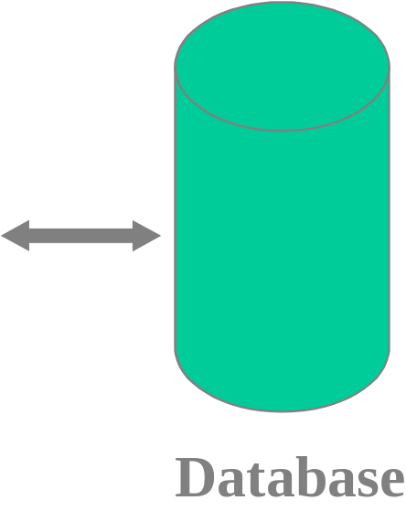
The ORACLE Environment
a DBMS kernal and integrated system catalog
non-procedural data language
user-friendly query language
sophisticated report writer
forms-based interface builder
host language compiler
utilities
Sql*Plus
ReportWriter
SQL*Forms
Programs
Utilities
USER
SQL
Kernal

Slide 5
SQL*Plus Statement Groups
Data Definition
Data Manipulation
CREATE TABLE/VIEW
ALTER
DROP
SELECT
INSERT
UPDATE
DELETE
Security/Authorisation
GRANT
REVOKE
Miscellaneous
Data Control
DESCRIBE
SPOOL
COMMIT
LOCK
ROLLBACK

Slide 6
Topic List
Writing Basic SQL Select Statements
Restricting and Sorting Data
Single-Row Functions
Displaying Data from Multiple Tables
Aggregating Data using Group Functions
Subqueries
Producing Readable Output with iSQL*Plus
Manipulating Data
Creating and Managing Tables
Including Constraints
Creating Views
Creating Other Database Objects

